Slide 1
The Determinants of Residential Segregation: An Implication of Discrete Choice Model
Xinyuan “Karl” Zou
Stata Conference 2019
Texas A&M University
Texas Research Data Center

Slide 2

Background
Persistent residential segregation in the US metropolis.
General trends of segregation level
What causes residential segregation
Three theoretical reasonings:
Racial Discrimination: Aversion for minorities, housing discrimination,
place stratification, and white flight hypothesis
Racial Preferences: Thomas Schelling’s model
Difference in Social Characteristics: Group differences in micro-level characteristics (e.g. income, occupation, education, better neighborhood outcomes, etc.).

Slide 3
Needs for New Methods and Data
Ongoing debate over which theoretical reasoning can explain the segregation patterns.
Recent studies tend to attribute segregation to either neighborhood outcomes or racial discrimination, with a strong inclination toward the later.
Limitations
Segregation patterns among minorities remain less studied.
Longitudinal nationally-representative sample cannot address the differential segregation patterns across regions.
Conventional locational attainment model captures either economic or racial composition of a neighborhood.
With new methods and data, I can examine the theories more rigorously.
Can discrimination theoretical line adequately explain the segregation patterns?
Besides race, can differences in social characteristics adequately explain locational outcomes?
Do households of all races avoid neighbors of other races in favor of neighbors of their own race?

Slide 4
Data and Methods
1940 Restricted IPUMS Full Count Micro-data
Advantage I: Extensive neighborhood attributes of the metropolis.
Advantage II: It provides extensive information of individual and household characteristics.
Discrete Choice Model
Advantage I: discrete choice model can consider multiple neighborhood attributes simultaneously in a single analysis.
Advantage II: It is able to address the ecological dependence problem.
Cities with different racial composition distributions.
For this study, it allows me to estimate how neighborhood attributes and household characteristics interactively determines residential choices among detail groups.
Data Citation. Ruggles, S., K. Genadek, R. Goeken, J. Grover, and M. Sobek. Integrated Public Use Microdata Series: Version 6.0 [Machine-readable database]. Minneapolis: University of Minnesota, 2015. (1940 IPUMS 100% Sample, Restricted File.) Disclaimer. Statistical analyses reported here were conducted under the guidelines and review policies of a project approved by the Minnesota Population Center (MPC). The views expressed in this research including those related to statistical, methodological, and technical issues, are solely those of the authors and do not necessarily reflect views of MPC. All results have been reviewed to ensure that no confidential information is disclosed.

Slide 5
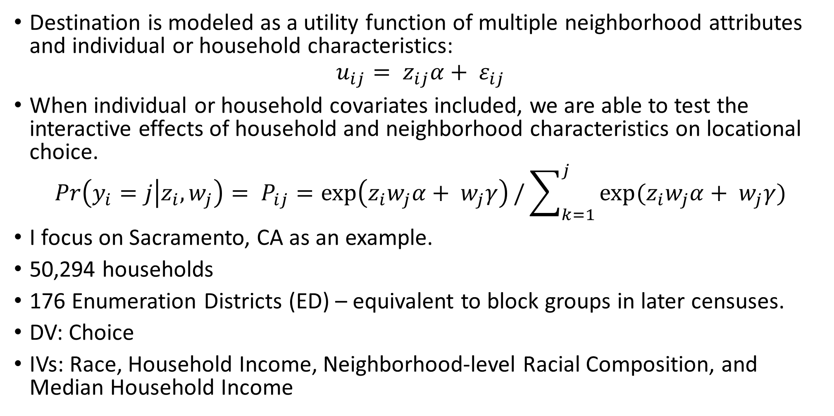
Data and Methods
Destination is modeled as a utility function of multiple neighborhood attributes and individual or household characteristics:
$$u_{ij}= z_{ij}α+ ε_{ij}$$
When individual or household covariates included, we are able to test the interactive effects of household and neighborhood characteristics on locational choice.
$$Pr\left(y_{i}=j | z_{i},w_{j}\right)= P_{ij}=\exp\left(z_{i}w_{j}α+ w_{j}γ\right)/\sum_{k=1}^{j}{exp(z_{i}w_{j}α+ w_{j}γ})$$
I focus on Sacramento, CA as an example.
50,294 households
176 Enumeration Districts (ED) – equivalent to block groups in later censuses.
DV: Choice
IVs: Race, Household Income, Neighborhood-level Racial Composition, and Median Household Income

Slide 6
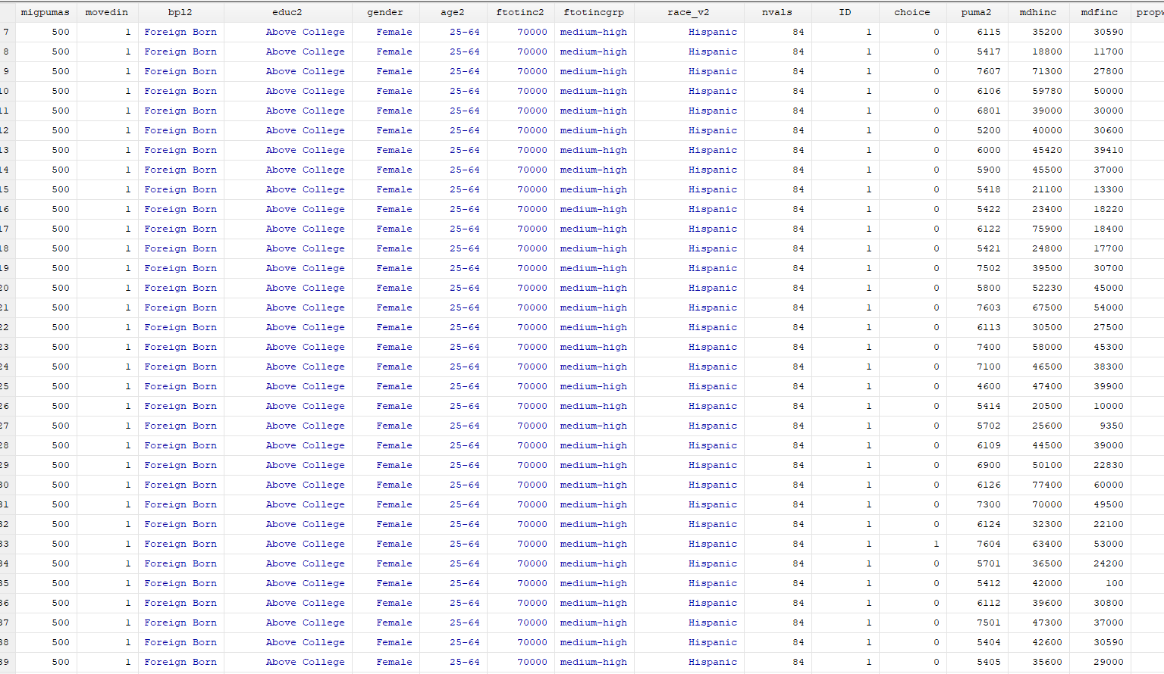
Data and Methods

Slide 7
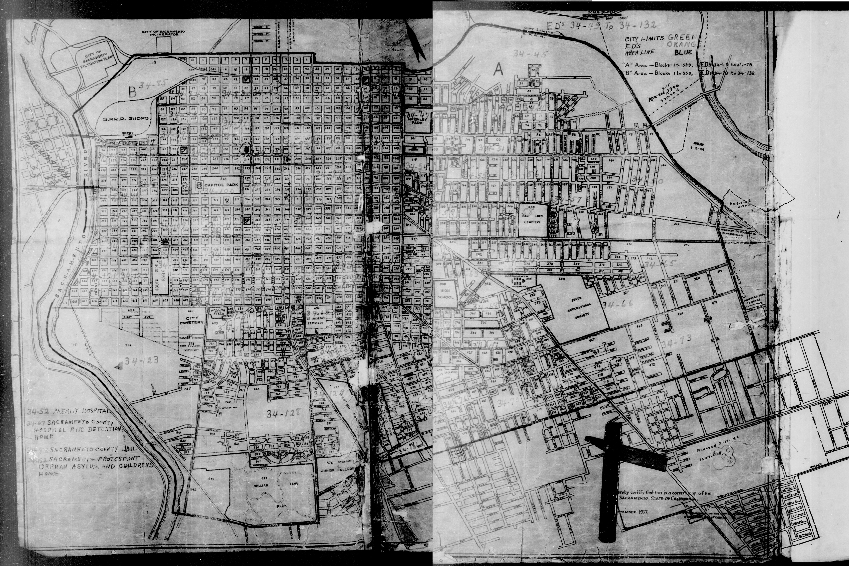

Slide 8
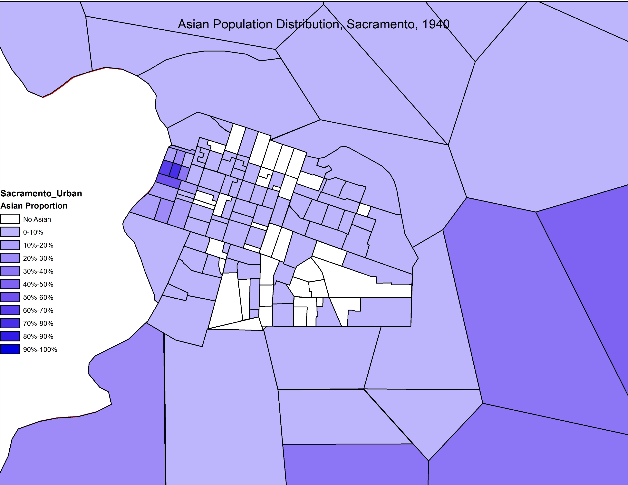

Slide 9
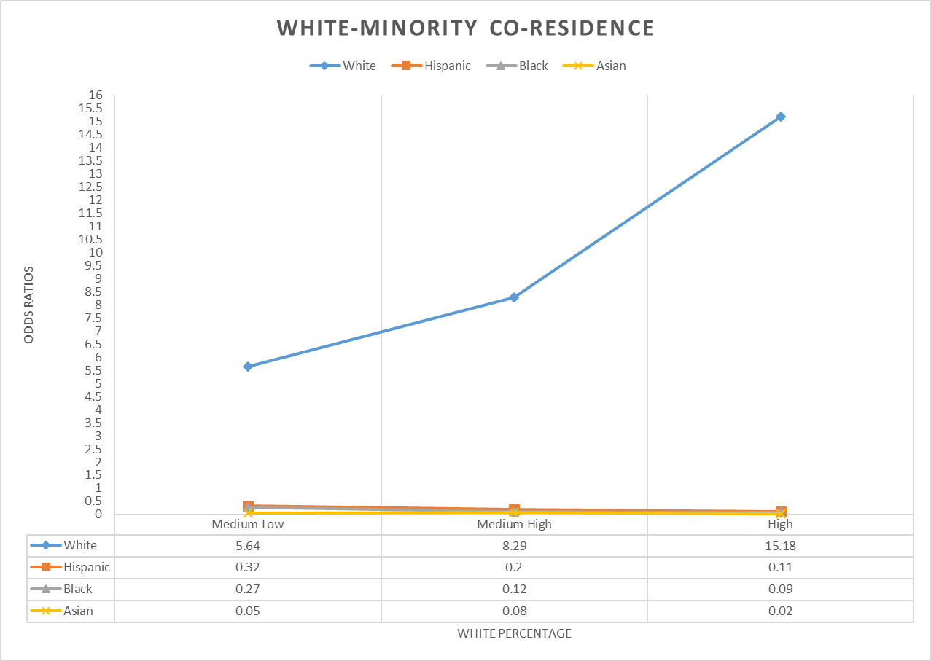
Preliminary Results

Slide 10
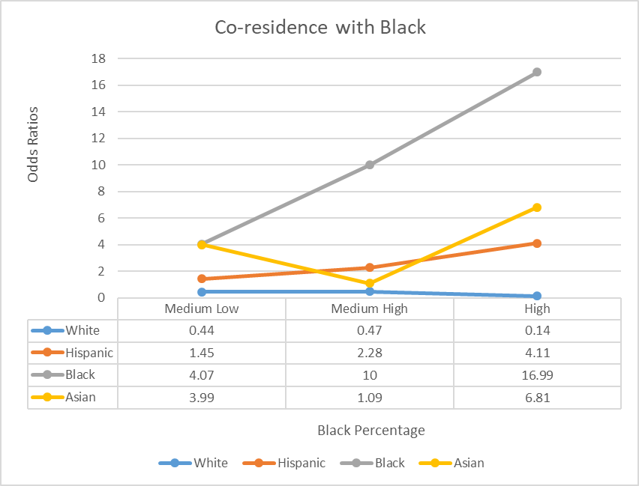
Preliminary Results

Slide 11
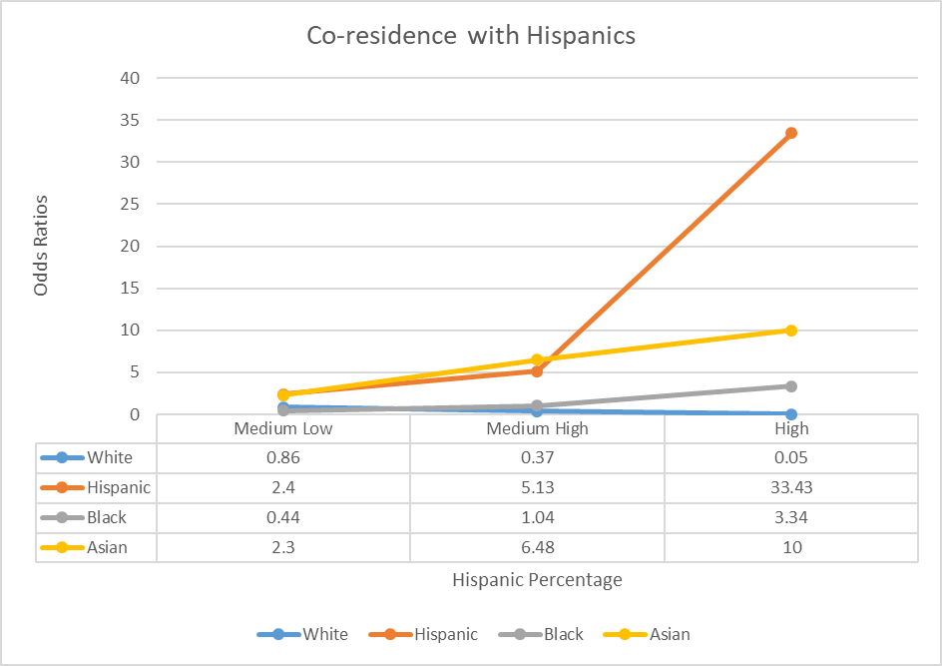
Preliminary Results

Slide 12
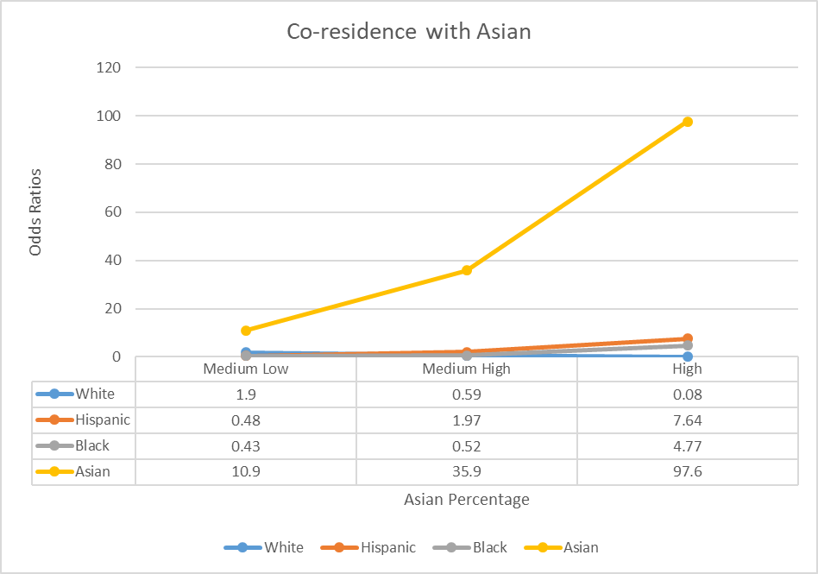
Preliminary Results

Slide 13
Preliminary Results
Minorities co-residence with whites.
With household income variable.
*** p<0.01 ** p<0.05 * p<0.1
Most coefficients in Model 2 become insignificant. Most interactions of household race and neighborhood-level white presence do not respond to income variation.
High income Asians are more likely to live in a moderately-white neighborhood.
Native-born White percentage (Neighborhood) | Asian |  | White |  | Black |  | Hispanic
 | Model I | Model 2 | Model I | Model 2 | Model I | Model 2 | Model I | Model 2
Medium Low | 0.03*** | 1.57(M) | 4,39*** | 1.07(M) | 0.25*** | 1.65(M) | 0.45*** | 0.97(M)
 |  | 7.60***(H) |  | 0.97(H) |  | 1.03(H) |  | 0.54(H)
Medium High | 0.21*** | 0.25***(M) | 5.77*** | 1.21(M) | 0.11*** | 2.07(M) | 0.25*** | 1.17(M)
 |  | 0.48 (H) |  | 0.59*(H) |  | 0.82(H) |  | 2.18*(H)
High | 0.09*** | 0.19***(M) | 10.3*** | 1.02(M) | 0.12*** | 1.39(M) | 0.12*** | 1.77*(M)
 |  | 0.3 (H) |  | 0.61(H) |  | 1.46(H) |  | 2.3*(H)

Slide 14
Preliminary Results
With household income variable and neighborhood median income.
*** p<0.01 ** p<0.05 * p<0.1
Asian and Hispanics’ residential choices rely more on neighborhood-level economic well-being.
White and black concern more about race instead of other neighborhood outcomes.
 | Asian |  |  | White |  |  | Black |  |  | Hispanic
NB-white % | Model I | Model 2 | Model 3 | Model I | Model 2 | Model 3 | Model 1 | Model2 | Model3 | Model I | Model2 | Model3
Medium Low | 0.03*** | 1.57 (M) | 2.07 (M) | 4,39*** | 1.07(M) | 0.88 (M) | 0.25*** | 1.65(M) | 1.63 (M) | 0.45*** | 0.97(M) | 1.21 (M)
 |  | 7.60*** (H) | 10.5 *** (H) |  | 0.97(H) | 0.91 (H) |  | 1.03(H) | 0.99 (H) |  | 0.54(H) | 0.53 (H)
Medium High | 0.21*** | 0.25*** (M) | 0.39*** (M) | 5.77*** | 1.21(M) | 0.92 (M) | 0.11*** | 2.07(M) | 2.1 (M) | 0.25*** | 1.17(M) | 1.59** (M)
 |  | 0.48 (H) | 0.9 (H) |  | 0.59*(H) | 0.51 (H) |  | 0.82(H) | 0.7 (H) |  | 2.18* (H) | 2.21* (H)
High | 0.09*** | 0.19*** (M) | 0.28 *** (M) | 10.3*** | 1.02(M) | 0.83 (M) | 0.12*** | 1.39(M) | 1.32 (M) | 0.12*** | 1.77* (M) | 2.33*** (M)
 |  | 0.3 (H) | 0.47 (H) |  | 0.61(H) | 0.62 (H) |  | 1.46(H) | 1.15 (H) |  | 2.3*(H) | 2.0 (H)

Slide 15
Discussion
Segregation patterns are multidimensional. One single theoretical line cannot adequately explain all dimensions.
All racial/ethnic groups demonstrate a high level of in-group preferences with Asian showing the highest.
Discrimination theoretical reasoning is justifiable in general as minorities barely live with whites and the likelihood of whites living in minority neighborhoods remain approximately constant.
In contrast with the contemporary understandings, spatial assimilation theory has a strong implication for European immigrants. We have to be really careful to extend the hypothesis to minorities, even Asians and Hispanics.
Consistent with the contemporary understanding, racial relationship between white and black is unique in the US. White’s aversion to black largely shapes the attitudes to co-residence for both parties.

Slide 16
Next
Edit neighborhood-level racial composition based on city-level attributes.
Study the cities with various distributions of neighborhood attributes.
More interactions of individual household and neighborhood attributes.

Slide 17
Replication
This study is done in a Stata environment.
Given the restricted data policy, I cannot share data with others.
A replicable workflow with public data has been archived.

Slide 18
Thanks you !!

